Slide 1
Secure Data Hiding in Image Using Steganography
CAPSTONE PROJECT
Presented By Student Name: Keshavprasad Motilal Kanojiya
College Name & Department: Ramniranjan Jhunjhunwala College
(Information Technology)

Slide 2
OUTLINE
Problem Statement
Technology used
Wow factor
End users
Result
Conclusion
Git-hub Link
Future scope

Slide 3
Problem Statement
In today's digital world, secure communication is essential to prevent data breaches and unauthorized access. Traditional encryption methods may raise suspicion, whereas steganography enables covert data transmission by hiding information within an image. This project implements an image-based steganographic technique to securely embed and retrieve hidden messages.

Slide 4
Technology used
Programming Language: Python
Libraries Used: OpenCV (cv2), OS, String
Platform: Windows/Linux

Slide 5
Wow factors
Enhanced Security: Uses password protection for decryption.
Stealth Communication: Hidden messages are indistinguishable from normal images.
User-Friendly Interface: Simple command-line input for embedding and extraction.
Efficient Performance: Low computational overhead.

Slide 6
End users
Cybersecurity Professionals: Secure communication without raising suspicion.
Journalists & Activists: Protect sensitive information in hostile environments.
Military & Government Organizations: Secure confidential data transmission.
General Users: Personal data protection.

Slide 7
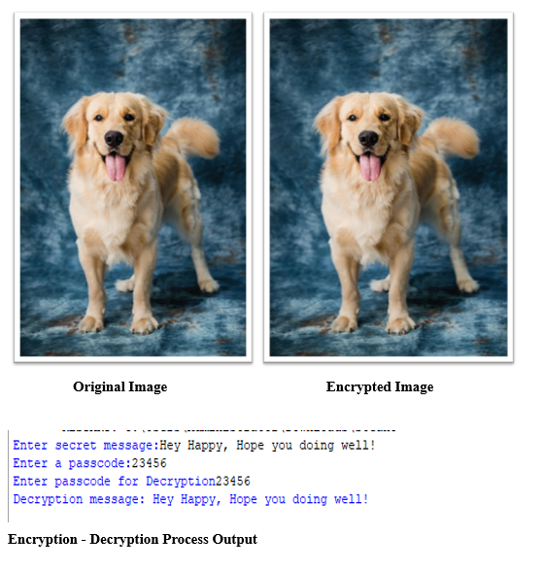
Results

Slide 8
Conclusion
This project successfully demonstrates secure data hiding using image steganography. By modifying pixel values to embed secret messages, it ensures confidentiality without attracting attention. The password-protected decryption mechanism enhances security, making this approach a viable option for discreet data transmission.

Slide 9
GitHub Link
https://github.com/Keshav200111/Edunet_Capstone-project.git

Slide 10
Future Scope
Implementing advanced steganography techniques like DCT-based and Deep Learning approaches.
Enhancing security with multi-layer encryption.
Developing a GUI-based application for better usability.
Optimizing storage efficiency to hide larger messages.

Slide 11
THANK YOU

